Slide 1
Maulana Azad National Institute of Technology, Bhopal
Department of Mathematics, Bioinformatics and Computer Application
MINOR PROJECT PRESENTATION
Hospital Management System
A role-aware web application for the complete hospital cycle — registration, appointments, clinical records, pharmacy, laboratory and settlement.
PROJECT GUIDES
Dr Jay Kumar Jain
Dr Kuldeep Singh Yadav
TEAM
Ashutosh Sharma
Bhavishya Sisodiya
Nitish Kumar
25204031148
25204031140
25204031115
Notes:
Minor project presentation for the Hospital Management System.

Slide 2
ROADMAP
Presentation Outline
01
Foundations
02
Architecture
Introduction · Problem · Scope · Objectives
System architecture · Technology stack · Modules
03
Access Control
04
Data Flow
Roles · Authentication and security flow
DFD Level 0 · Level 1 · seven Level 2 diagrams
05
Data Design
06
Use Cases
ERD across three domains · Database schema
Eight role-specific use case diagrams
07
API & AI
08
Build & Delivery
REST design · Assistant pipeline · Tool permissions
Frontend · Backend · Security · Deployment · QA
Hospital Management System
2 / 45

Slide 3
FOUNDATIONS
Introduction
The Hospital Management System is a role-aware web application that digitises the complete operational cycle of a hospital — from patient registration and appointment booking through admission, treatment, prescribing, laboratory investigation, dispensing and final settlement.
At a glance
27
database tables
One connected record
Eight distinct viewpoints
168
A patient's identity, visits, vitals, records, prescriptions, results and bills stay linked through foreign keys.
Admin, doctor, nurse, receptionist, pharmacist, lab technician, accountant and patient each see only their own workspace.
API endpoints
30
API routers
Single deployable process
Assistive intelligence
FastAPI serves the API and the compiled React bundle from the same origin.
A role-gated LLM assistant answers scheduling and operational questions through 14 database-backed tools.
8
user roles
Hospital Management System
3 / 45

Slide 4
FOUNDATIONS
Problem Statement
01
Fragmented paper records
02
Repeated manual entry
03
No unified availability view
Patient history spread across files and registers.
Clinical decisions without a complete longitudinal view.
The same demographic captured at reception, ward and billing.
Every hand-off a fresh transcription of the same data.
Bed and slot occupancy not visible while booking.
Patients discover conflicts only at the counter.
04
Untraceable clinical history
05
Slow settlement
06
Uncontrolled data access
Records, vitals, results and prescriptions held apart.
No single timeline per patient.
Manual invoice assembly across departments.
Payment status not visible to the patient.
One shared login could reach every record.
No role boundary between clinical and administrative data.
Hospital Management System
4 / 45

Slide 5
FOUNDATIONS
Project Scope
The system covers eleven functional domains served by thirty API routers. Every domain is modelled in PostgreSQL and exposed through role-gated REST endpoints.
Identity & access
Hospital setup
Staff & doctors
Patients
Appointments
Admissions & wards
Clinical records
Laboratory
Pharmacy & inventory
Billing & payments
Dashboards & AI
Deployment model
Integration style
Intelligence layer
A single FastAPI process serves the JSON API, the compiled frontend bundle and the SPA fallback route.
Frontend and backend communicate over a documented REST surface consumed through 30 Axios service modules.
An OpenAI-compatible LLM endpoint, Ollama by default, is wrapped by a tool dispatcher gated on role.
Hospital Management System
5 / 45

Slide 6
FOUNDATIONS
Objectives
1
Digitise the hospital workflow
5
Expose a clean API
Replace register-based operation with a single relational model covering every stage of care.
Thirty routers and 168 endpoints following consistent REST verbs with Pydantic request and response schemas.
2
Enforce role-based access control
6
Deliver usable dashboards
Eight roles, two account types, and server-side guards on every protected endpoint.
Seven staff dashboards plus a patient dashboard, each fed by scoped aggregate queries.
3
Guarantee data integrity
7
Add assistive intelligence
Foreign keys, check constraints and indexes on hot lookup columns such as patient, doctor, bed and status.
A conversational assistant grounded in live database state rather than free-form generation.
4
Model the domain explicitly
8
Keep deployment simple
Twenty-seven tables capturing identity, hospital, clinical, inpatient, laboratory, pharmacy and finance data.
One container image serving API, static assets and a guarded SPA fallback route.
Hospital Management System
6 / 45

Slide 7
ARCHITECTURE
System Architecture
Three-tier architecture served from a single process
PRESENTATION LAYER
01
02
03
04
05
React 19 SPA
React Router 7 client routing
Role-aware Sidebar & Navbar
Axios API service layer
ChatBot assistant widget
APPLICATION LAYER
01
02
03
04
05
06
FastAPI REST API
JWT auth + role guards
30 routers / 168 endpoints
Pydantic validation
Global exception handlers
AI chat router
DATA LAYER
01
02
03
04
05
PostgreSQL
SQLAlchemy 2.0 ORM
27 relational tables
Alembic migrations
bcrypt password hashing
HTTPS / JSON request + response
Hospital Management System
7 / 45

Slide 8
ARCHITECTURE
Technology Stack
Frontend and tooling
Backend, data and AI
Technology
Version
Purpose
Technology
Version
Purpose
React
19.2.8
Component-based SPA
FastAPI
0.141.1
REST API framework
Vite
8.2.2
Dev server and bundler
Uvicorn
0.52.4
ASGI server
React Router DOM
7.18.3
Client-side routing
SQLAlchemy
2.0.52
ORM and data access
Axios
1.20.0
HTTP service layer
psycopg2-binary
2.9.13
PostgreSQL driver
Oxlint
1.79.0
Static analysis
Alembic
1.19.2
Schema migrations
python-jose
3.5.0
JWT encode and decode
Passlib / bcrypt
1.7.4 / 4.0.1
Password hashing
Pydantic
2.13.5
Request validation
pydantic-settings
2.15.0
Environment configuration
HTTPX
0.28.1
OpenAI-compatible LLM client
Hospital Management System
8 / 45

Slide 9
ARCHITECTURE
Functional Modules
01
Identity & Access
02
Hospital Setup
03
Staff & Doctors
04
Patients
Patient self-registration
Login and JWT issue
Role master
Hospitals and departments
Rooms and beds
Availability queries
Employee directory
Doctor profiles
Weekly schedules
Registration and profile
Patient and staff views
3 routers
4 routers
3 routers
1 router
05
Appointments
06
Admissions & Wards
07
Clinical Records
08
Laboratory
Slot booking and cancel
Booked-slot views
Admit and discharge
Nurse assignment
Medical records
Vitals capture
Prescriptions
Test type catalogue
Test orders
Result entry
1 router
2 routers
3 routers
3 routers
09
Pharmacy
10
Billing & Payments
11
Dashboards & AI
30 routers
Medicine master
Batch and expiry
Stock by pharmacy
Invoices and items
Payment capture
Aggregate statistics
Tool-gated assistant
Every module exposed over
consistent REST verbs
6 routers
3 routers
2 routers
168 endpoints
Hospital Management System
9 / 45

Slide 10
ACCESS CONTROL
Roles and Access Model
Accounts are split into two types. A patient account can only ever address patient-scoped routes; a member account must additionally carry one of seven staff roles, checked on every protected request.
account_type = patient
account_type = member
require_patient guard. Self-service on own appointments, records, results, prescriptions, vitals, admissions, invoices and payments.
require_member or require_role guard. Staff workspaces for admin, doctor, nurse, receptionist, pharmacist, lab_technician and accountant.
1
Administrator
2
Doctor
3
Nurse
4
Receptionist
admin
doctor
nurse
receptionist
Full control of every master record and dashboard
Appointments, patients, records, prescriptions, schedule
Assigned patients and vitals recording
Patients, appointments, admissions, billing
5
Pharmacist
6
Lab Technician
7
Accountant
8
Patient
pharmacist
lab_technician
accountant
patient
Prescription billing and stock control
Test types, lab tests and result entry
Invoices, invoice items and payments
Own records, results, prescriptions, vitals, bills
Hospital Management System
10 / 45

Slide 11
ACCESS CONTROL
Authentication and Security Flow
Bearer token issued at login, validated on every request
01
02
03
04
POST /auth/login
bcrypt verify
JWT signed by python-jose
Client sends Authorization: Bearer
05
06
07
HTTPBearer extracts token
Resolve user, check is_active
require_role gate
Password storage
Passlib CryptContext with the bcrypt scheme. Hashing rejects any password longer than 72 bytes, and verification refuses the same.
Token contents
The subject claim carries the numeric user id. A missing, malformed or undecodable token is rejected before any database access.
Failure responses
Missing or invalid credentials return 401 with a WWW-Authenticate: Bearer header. An inactive account or a failed role check returns 403.
Hospital Management System
11 / 45

Slide 12
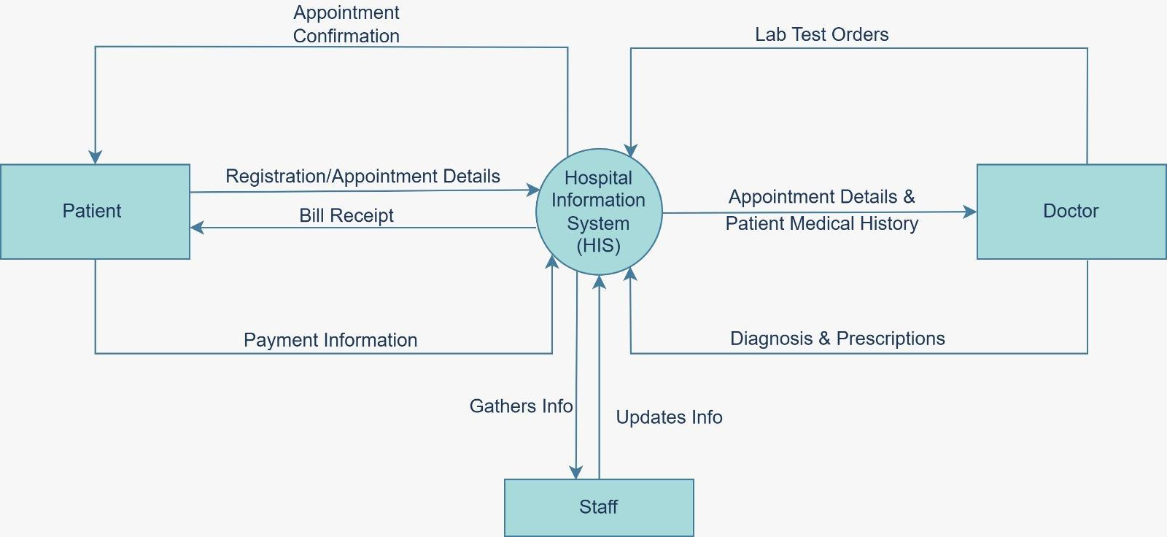
DATA FLOW
DFD Level 0 — Context Diagram
The entire hospital function represented as a single process
Hospital Management System
12 / 45

Slide 13
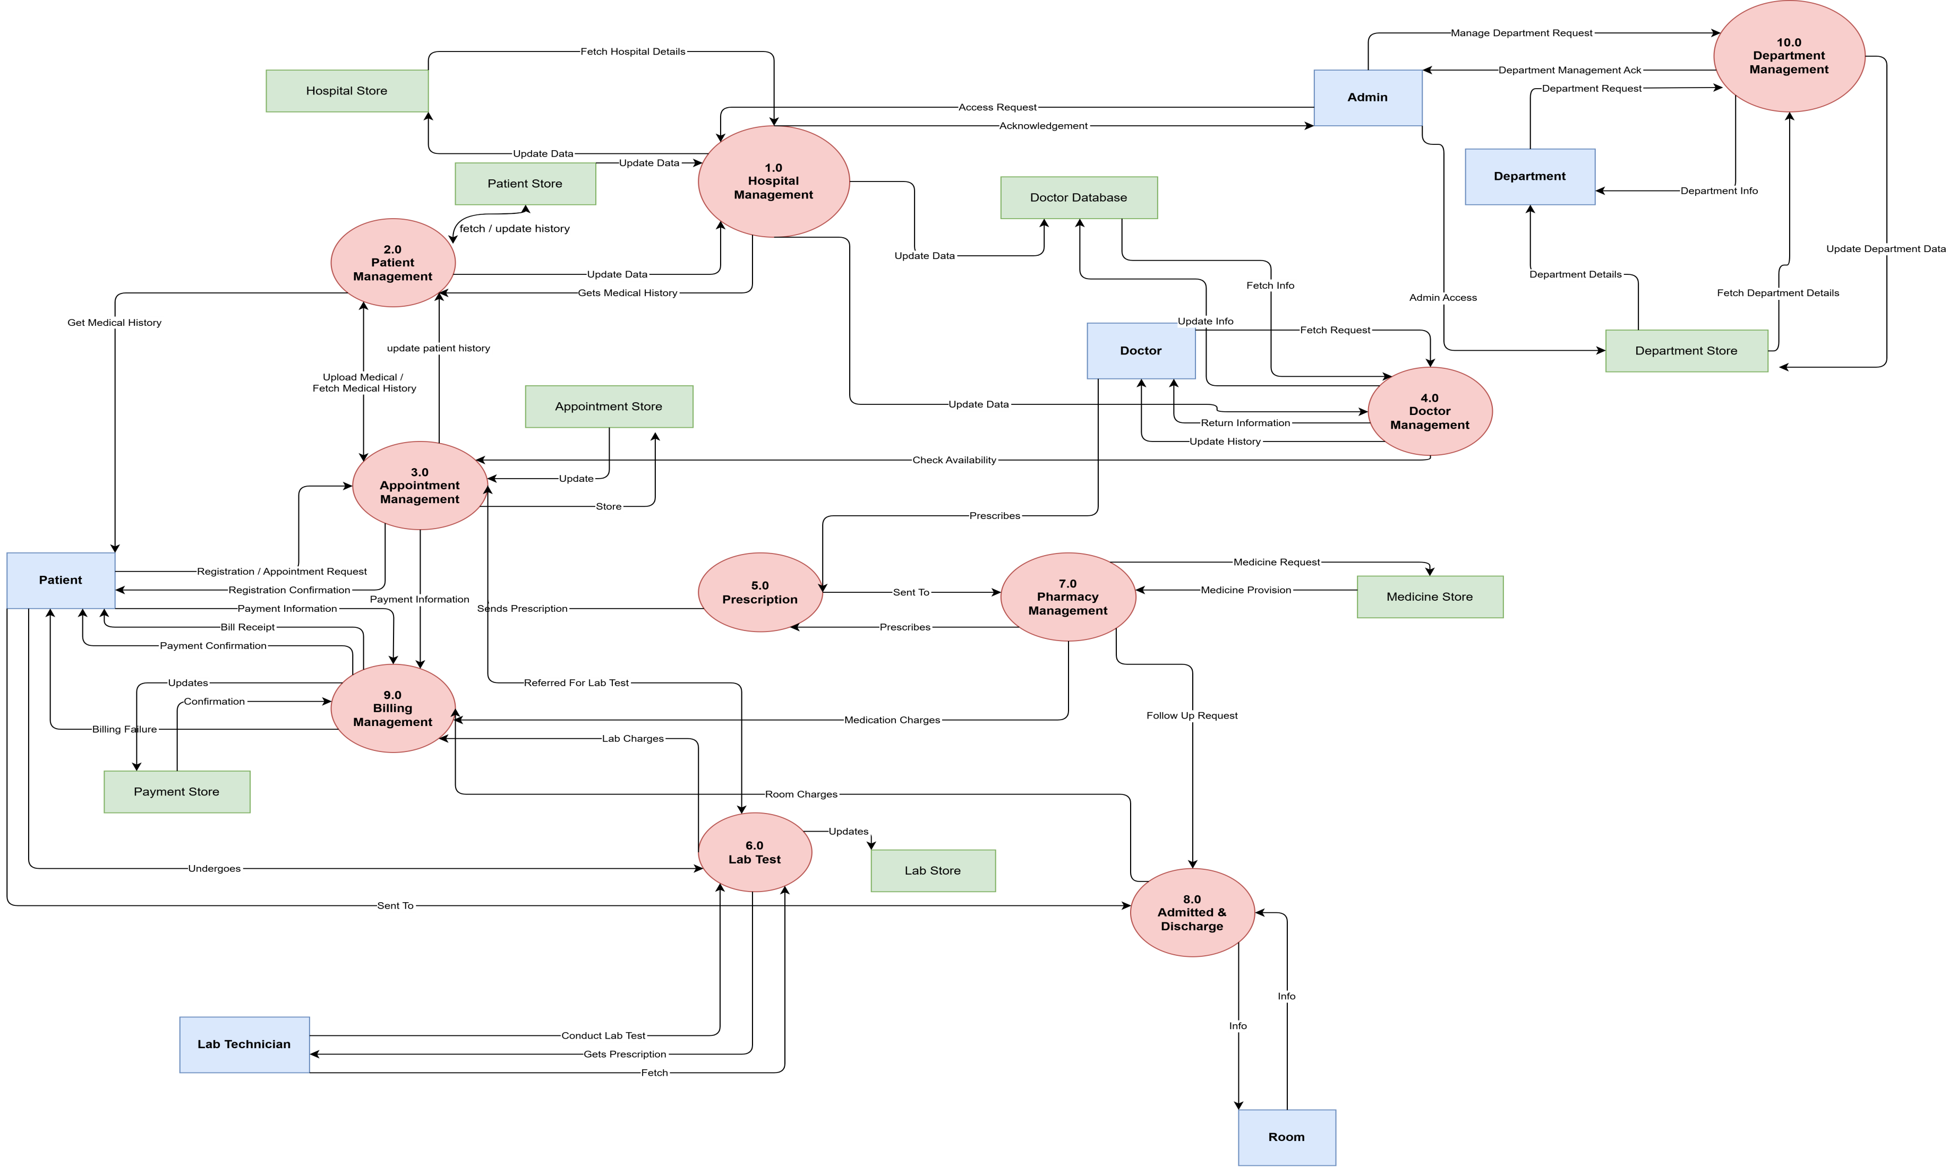
DATA FLOW
DFD Level 1
Six major processes over the supporting data stores
Hospital Management System
13 / 45

Slide 14
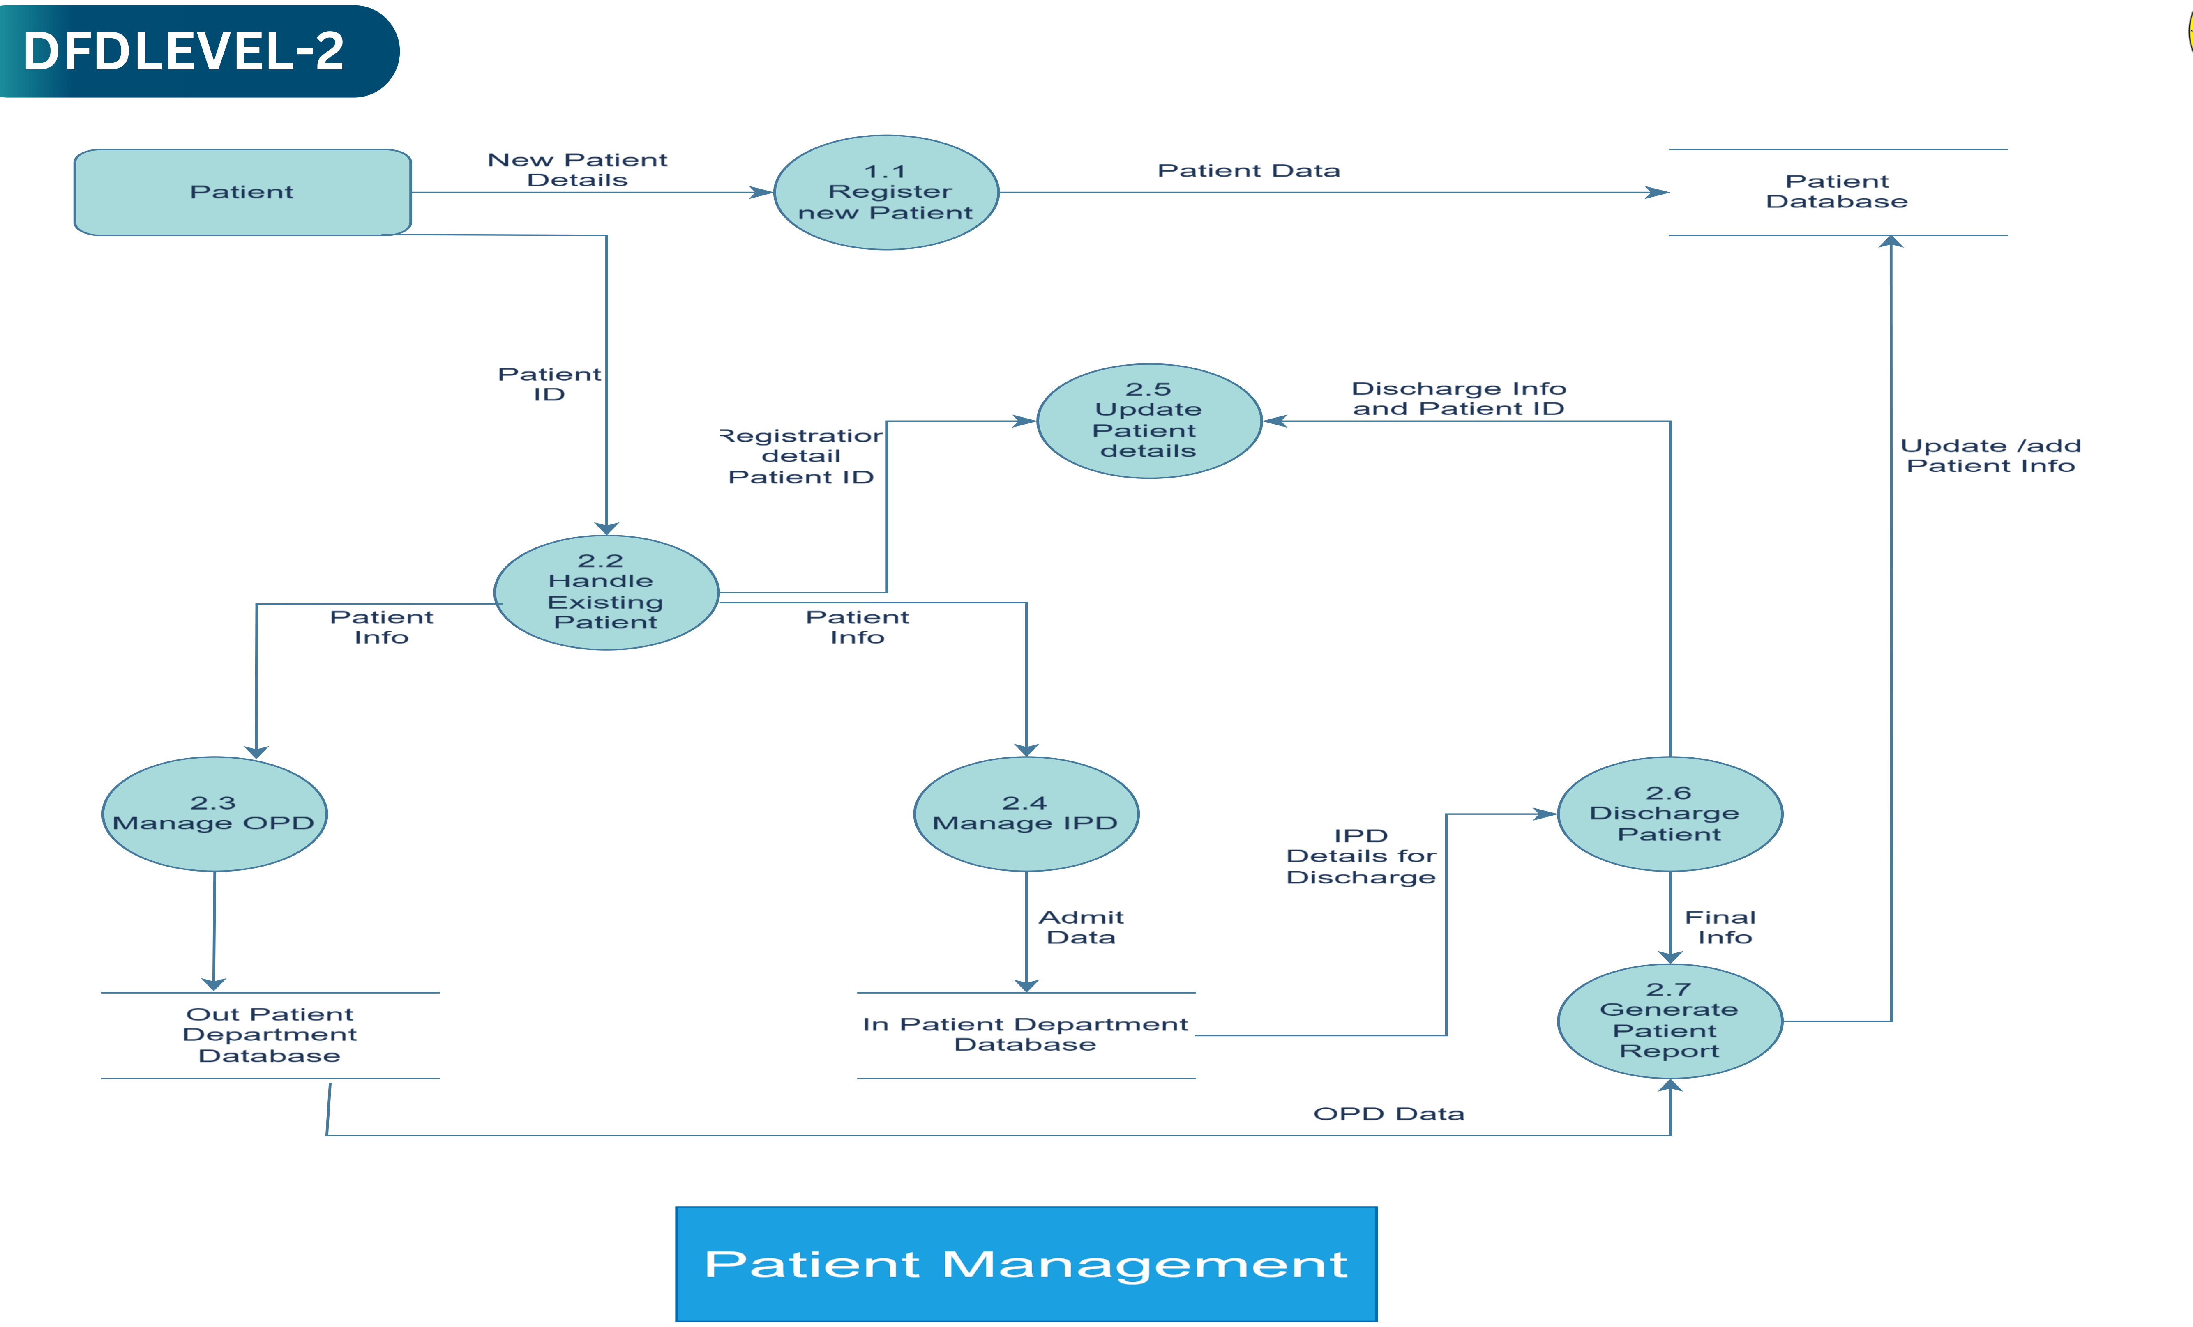
DATA FLOW
DFD Level 2 — Patient and Registration
Hospital Management System
14 / 45

Slide 15
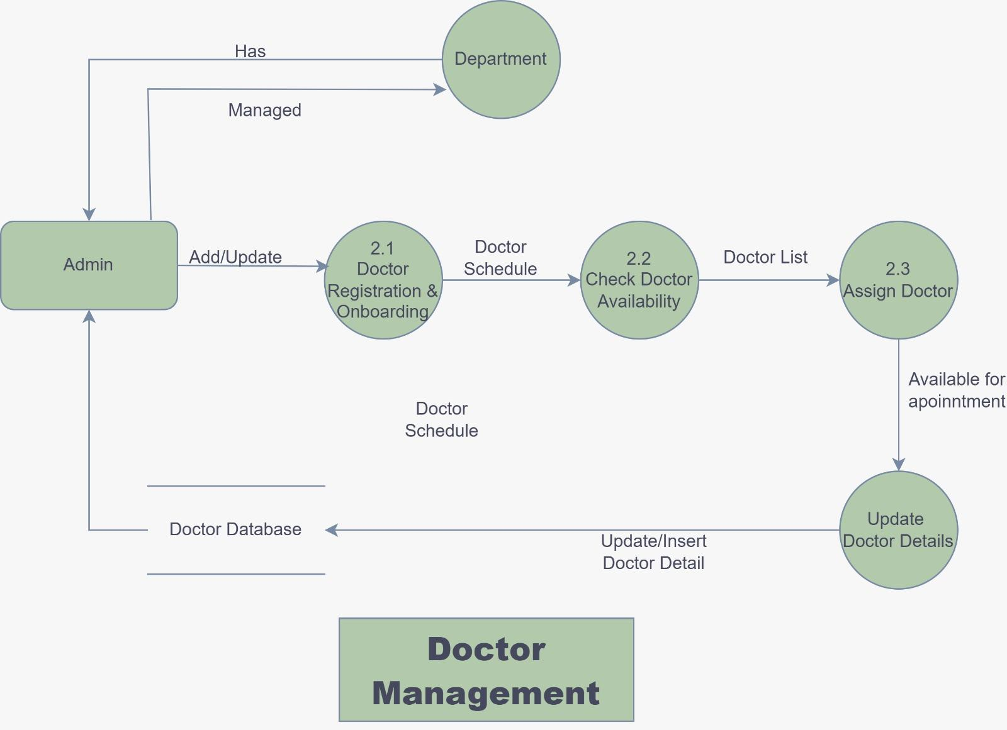
DATA FLOW
DFD Level 2 — Appointments and Scheduling
Hospital Management System
15 / 45

Slide 16
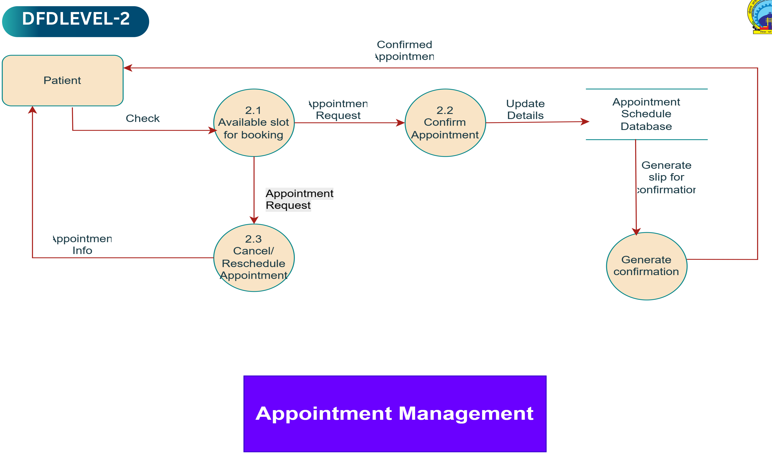
DATA FLOW
DFD Level 2 — Clinical Records and Vitals
Hospital Management System
16 / 45

Slide 17
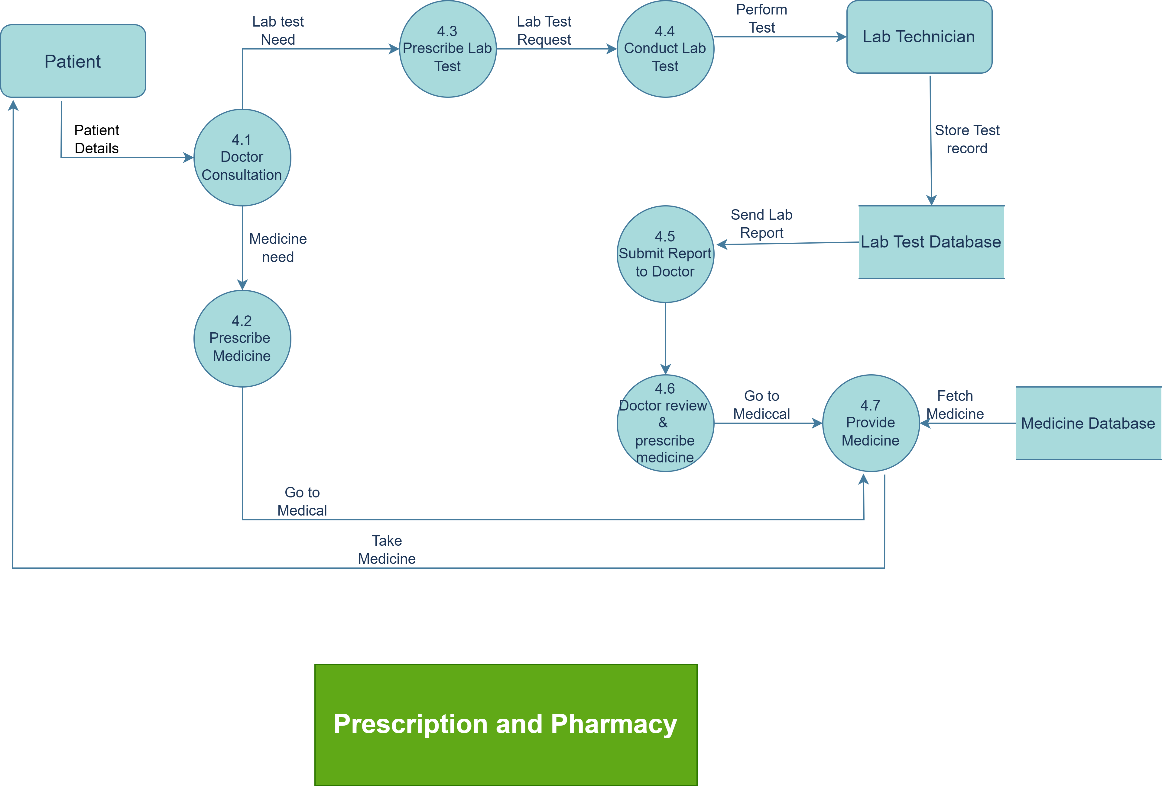
DATA FLOW
DFD Level 2 — Pharmacy and Inventory
Hospital Management System
17 / 45

Slide 18
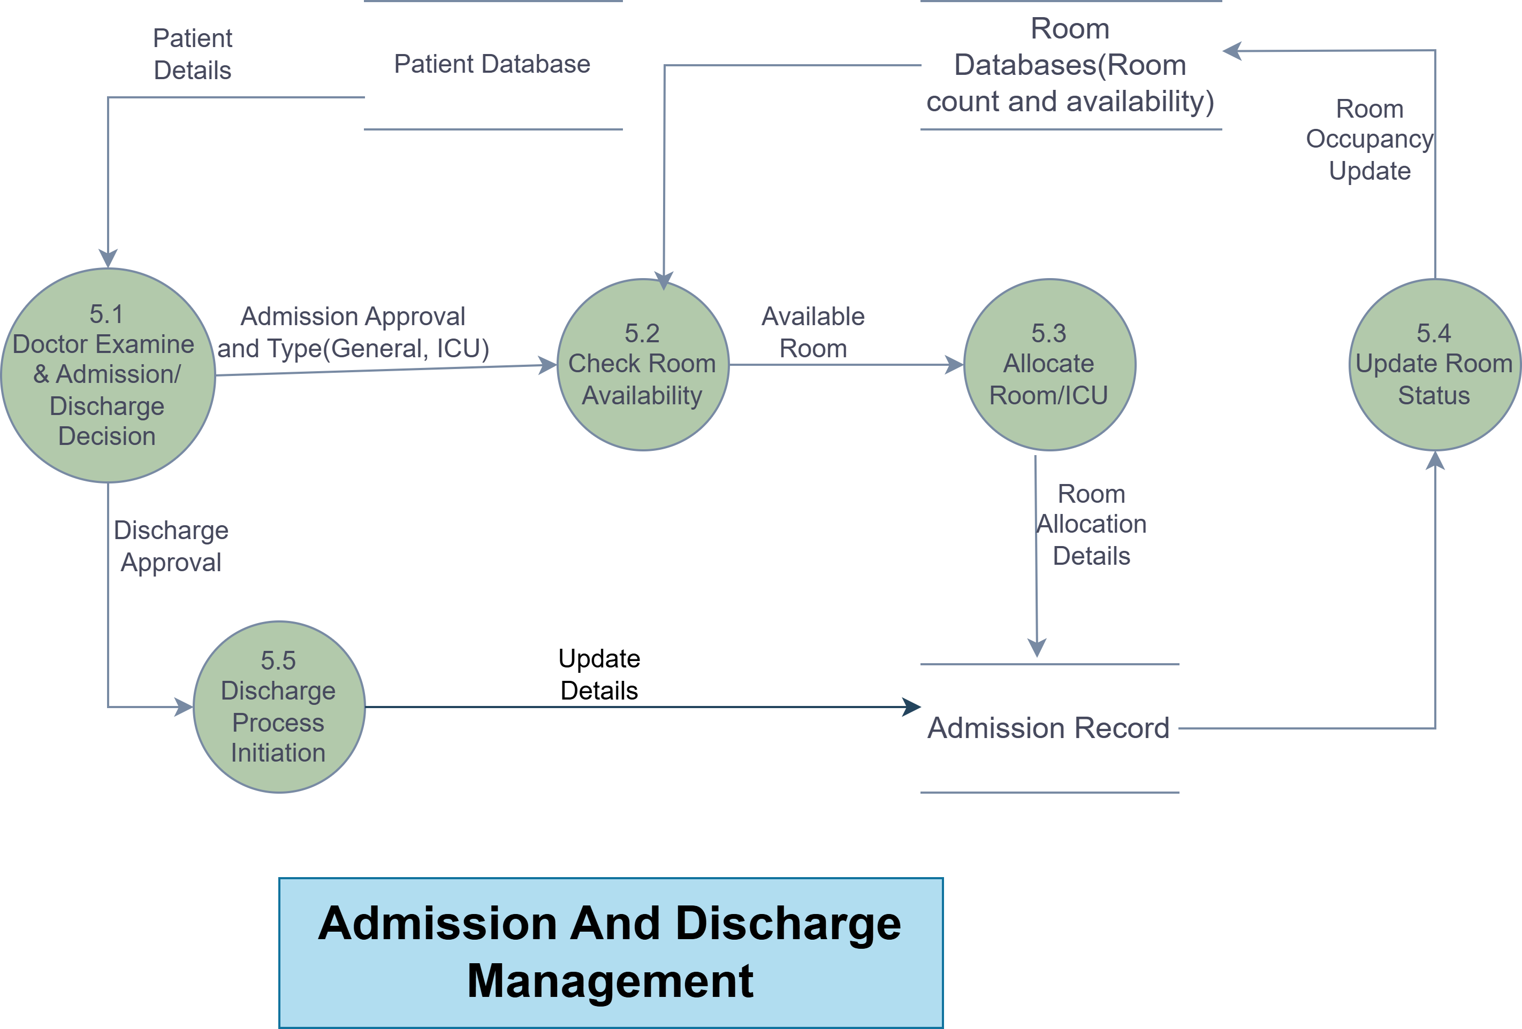
DATA FLOW
DFD Level 2 — Laboratory
Hospital Management System
18 / 45

Slide 19
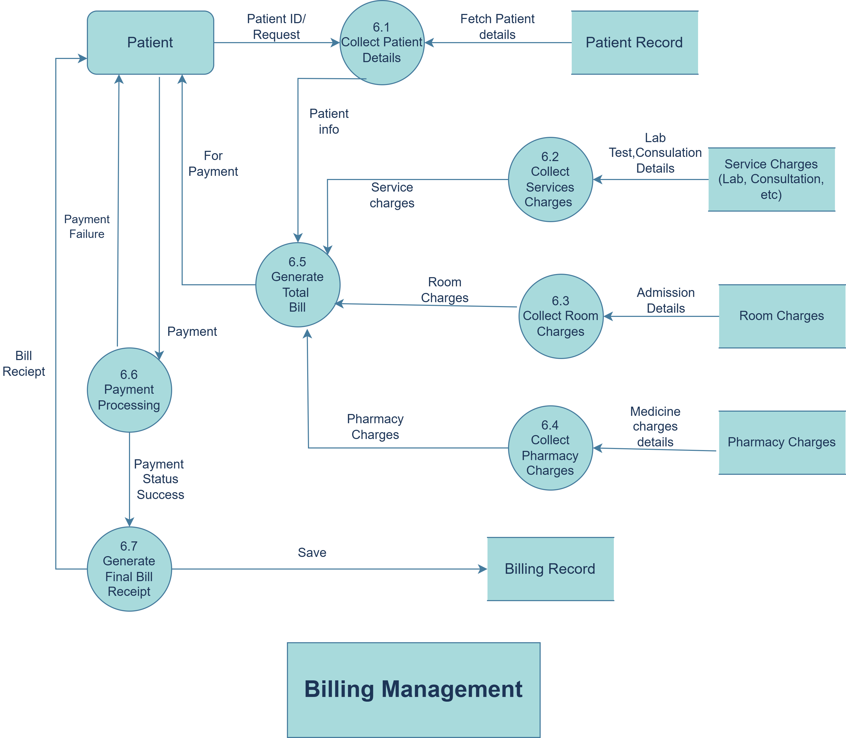
DATA FLOW
DFD Level 2 — Billing and Payments
Hospital Management System
19 / 45

Slide 20
DATA FLOW
DFD Level 2 — Infrastructure and Support
EXTERNAL ENTITIES
PROCESSES
DATA STORES
OUTPUTS
Administrator
Register hospital and department
Manage rooms and beds
hospitals
Availability view
7.1
7.2
departments
Nurse
Maintain employees and doctors
Publish dashboards
rooms
Headcount summary
7.3
7.4
beds
Receptionist
Serve assistant queries
employees
Assistant answer
7.5
dashboard stats
External entity
Process
Data store
Output / report
Hospital Management System
20 / 45

Slide 21
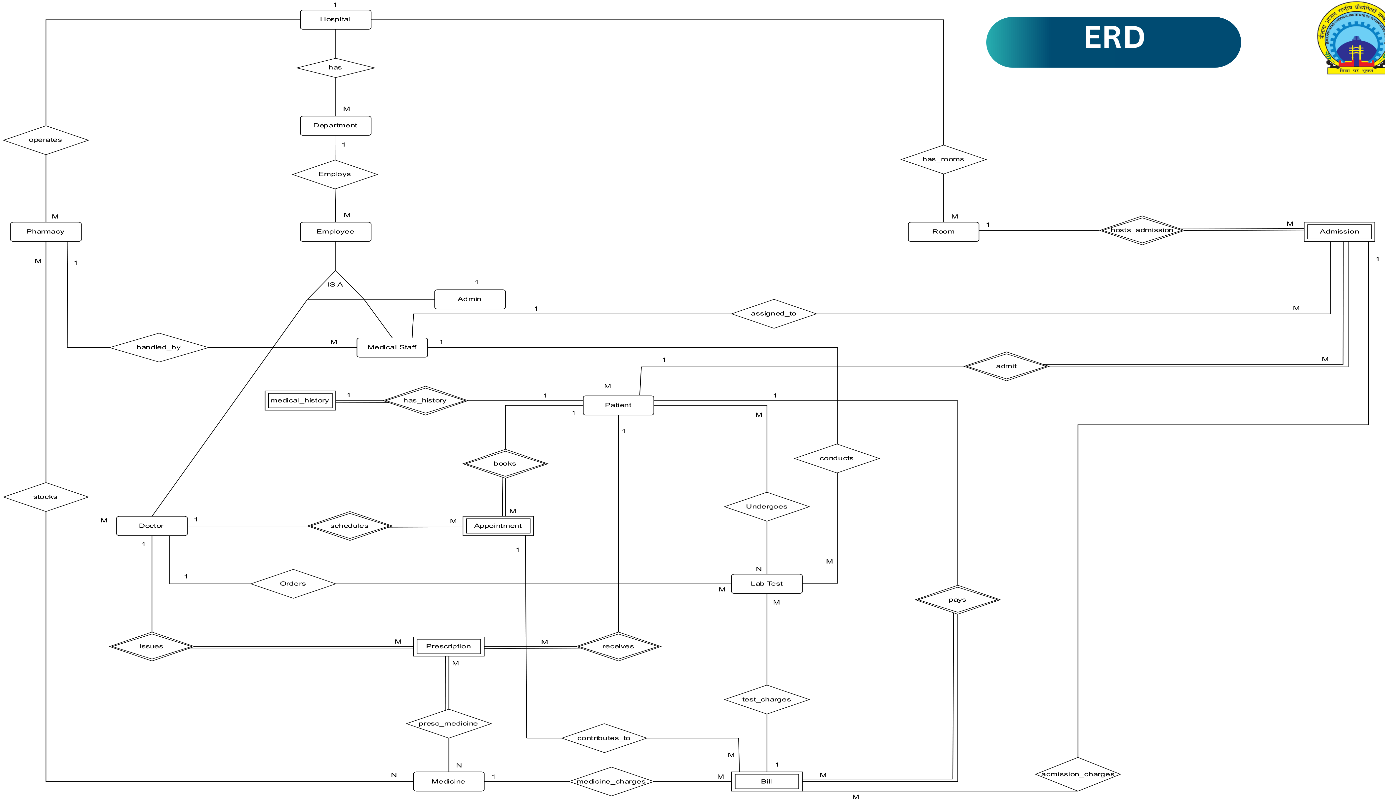
DATA DESIGN
ERD — Identity, Access and Setup
Seven entities: who exists, what they may do, and where they sit
Hospital Management System
21 / 45

Slide 22
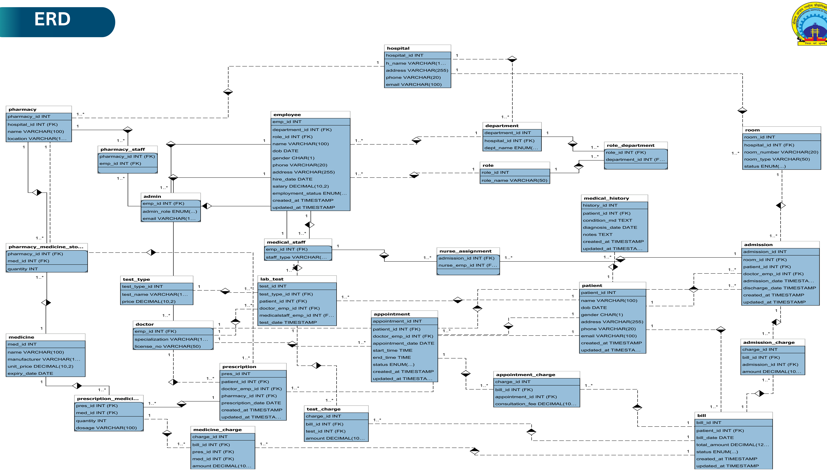
DATA DESIGN
ERD — Clinical Workflow
Ten entities linking a patient to every clinical event
Hospital Management System
22 / 45

Slide 23
DATA DESIGN
ERD — Diagnostics, Pharmacy and Finance
Twelve entities closing the prescription-to-payment chain
test_types
lab_tests
lab_results
prescriptions
*id PK
1
*id PK
*id PK
*id PK
name
*test_types_id FK
1
*lab_tests_id FK
1
*patients_id FK
price
N
*patients_id FK
result_value
N
*doctors_id FK
*doctors_id FK
reported_at
*pharmacies_id FK
medicines
medicine_batches
pharmacies
pharmacy_stock
*id PK
*id PK
*id PK
1
*id PK
name
1
*medicines_id FK
1
*hospitals_id FK
1
*pharmacies_id FK
unit
batch_no
name
N
*medicine_batches_id FK
unit_price
expiry_date
quantity
1
prescription_medicines
invoices
invoice_items
payments
*prescriptions_id FK
*id PK
*id PK
N
*id PK
*medicines_id FK
*patients_id FK
1
*invoices_id FK
*invoices_id FK
dosage
total_amount
1
description
amount
status
amount
method
Hospital Management System
23 / 45

Slide 24
DATA DESIGN
Database Schema Overview
All 27 tables grouped into eight domains
Identity & Access
Hospital Setup
Clinical
Inpatient
users
hospitals
appointments
admissions
roles
departments
doctor_schedules
nurse_assignments
patients
rooms
medical_records
employees
beds
vitals
doctors
Laboratory
Pharmacy
Prescribing
Finance
test_types
medicines
prescriptions
invoices
lab_tests
medicine_batches
prescription_medicines
invoice_items
lab_results
pharmacies
payments
pharmacy_stock
Hospital Management System
24 / 45
Notes:
Every table is declared in SQLAlchemy and materialised by a single Alembic migration, so the deployed schema matches the model definitions exactly.

Slide 25
USE CASES
Use Case Diagram — Patient
Self-service on the patient's own record
HOSPITAL MANAGEMENT SYSTEM
Patient
Dashboard
Profile
Appointments
Doctors
Medical Records
Lab Results
Prescriptions
Vitals
Admissions
Billing
Payments
Hospital Management System
25 / 45

Slide 26
USE CASES
Use Case Diagram — Doctor
Clinical workspace for a practising doctor
HOSPITAL MANAGEMENT SYSTEM
Doctor
Dashboard
Appointments
Patients
Medical Records
Prescriptions
Doctor Schedule
Hospital Management System
26 / 45

Slide 27
USE CASES
Use Case Diagram — Nurse
Focused on ward assignment and vitals capture
HOSPITAL MANAGEMENT SYSTEM
Nurse
Dashboard
Assigned Patients
Record Vitals
Hospital Management System
27 / 45

Slide 28
USE CASES
Use Case Diagram — Receptionist
Front-desk operations from registration to admission
HOSPITAL MANAGEMENT SYSTEM
Receptionist
Dashboard
Patients
Appointments
Admissions
Billing
Hospital Management System
28 / 45

Slide 29
USE CASES
Use Case Diagram — Pharmacist
Dispensing and stock control
HOSPITAL MANAGEMENT SYSTEM
Pharmacist
Dashboard
Prescriptions & Billing
Medicines
Medicine Batches
Pharmacies
Pharmacy Stock
Hospital Management System
29 / 45

Slide 30
USE CASES
Use Case Diagram — Lab Technician
Test catalogue, processing and result entry
HOSPITAL MANAGEMENT SYSTEM
Lab Technician
Dashboard
Lab Prescriptions & Billing
Test Types
Lab Tests
Lab Results
Hospital Management System
30 / 45

Slide 31
USE CASES
Use Case Diagram — Accountant
Invoice and payment settlement
HOSPITAL MANAGEMENT SYSTEM
Accountant
Dashboard
Invoices
Invoice Items
Payments
Hospital Management System
31 / 45

Slide 32
USE CASES
Use Case Diagram — Administrator
Configuration authority across all 21 master screens
HOSPITAL MANAGEMENT SYSTEM
Administrator
Dashboard
Hospitals
Employees
Doctors
Patients
Departments
Appointments
Admissions
Rooms
Beds
Nurse Assignments
Test Types
Lab Tests
Lab Results
Medicines
Medicine Batches
Pharmacies
Pharmacy Stock
Invoices
Invoice Items
Payments
Hospital Management System
32 / 45

Slide 33
API AND AI
REST API Design
Thirty routers exposing 168 endpoints under consistent verbs
Router
Verbs
Ops
Responsibility
/patients
GET, POST, PUT, DELETE
7
Profile, staff listings, self view
/appointments
GET, POST, PUT, DELETE
8
Booking, doctor slots, cancel
/admissions
GET, POST, PATCH, DELETE
8
Admit, discharge, by patient or doctor
/medical-records
GET, POST, PATCH, DELETE
7
Records by patient or doctor
/vitals
GET, POST, PATCH, DELETE
7
Vitals by patient or employee
/lab-results
GET, POST, PATCH, DELETE
6
Result entry and patient view
/prescriptions
GET, POST, PATCH, DELETE
6
Issue by doctor, view by patient
/pharmacy-stock
GET, POST, PATCH, DELETE
5
Stock by pharmacy and batch
/invoices
GET, POST, PATCH, DELETE
6
Invoice master, own-invoice view
/payments
GET, POST, PATCH, DELETE
5
Settlement against an invoice
/auth
POST
2
Patient registration and login
/dashboard, /chat
GET, POST
3
Aggregate statistics, assistant query
Every route carries an explicit FastAPI prefix, and protected routes declare a require_patient, require_member, require_admin or require_role dependency.
Hospital Management System
33 / 45

Slide 34
API AND AI
AI Assistant Architecture
Role-gated tool calling over live database state
USER MESSAGE
API GATE
LLM CLIENT
TOOL DISPATCH
DATABASE
ChatBot.jsx widget
get_current_user
OpenAI-compatible POST
14 registered tools
Live query execution
Role-aware prompt
Role resolution
Model qwen2.5:3b
JSON action parse
Result passed back
Message history
Tool allow-list
Temp 0.3 · 850 tokens
Role permission map
Answer composed
RESILIENCE
Four retries with exponential backoff and respect for a Retry-After header on 429 responses.
Backoff capped at thirty seconds to keep a chat turn responsive.
Any OpenAI-compatible endpoint works: Ollama locally, or a hosted provider through environment variables.
The assistant never generates clinical data; it only reports what the database returns.
Hospital Management System
34 / 45

Slide 35
API AND AI
Assistant Tools and Role Permissions
Fourteen tools are registered, but each is granted only to the roles that may legitimately call it. Confidential clinical data is restricted to doctors and administrators.
PATIENT TOOLS · 5
STAFF TOOLS · 9
list_doctors
doctor_info
admin, doctor
List all doctors with specialisation and department
patient_lookup
admin, doctor, nurse, receptionist, pharmacist, lab_technician
doctor_schedule
patient_medical_history
admin, doctor
Get a doctor's weekly schedule
patient_vitals
admin, doctor
book_appointment
today_summary
admin, doctor, nurse, receptionist, pharmacist, lab_technician
Book an appointment for the logged-in patient
bed_occupancy
admin, doctor, nurse, receptionist
my_appointments
List the logged-in patient's appointments
low_stock
admin, doctor, nurse, pharmacist
cancel_appointment
department_summary
admin, doctor, nurse, receptionist, pharmacist, lab_technician
Cancel the logged-in patient's appointment
my_assignments
admin, nurse
Hospital Management System
35 / 45

Slide 36
BUILD AND DELIVERY
Business Rules Enforced by the System
1
Admission status lifecycle
5
Prescribing chain
An admission may only be admitted, discharged or cancelled, enforced by a check constraint. Discharge date cannot precede the admission date.
A prescription links patient, doctor and pharmacy, and each line resolves through prescription_medicines to a medicine and its batch.
2
Bed occupancy
6
Billing integrity
A bed belongs to exactly one room, and room availability is derived from the beds underneath it rather than stored separately.
Payments reference an invoice and invoice items reference the same invoice, so a receipt can never exist without a bill.
3
Slot validity
7
Account activity
An appointment must fall inside the doctor's declared weekly schedule, and the slot must be free before the booking is written.
A deactivated account is refused with 403 even when its token is still cryptographically valid.
4
Patient identity
8
Password ceiling
A patient profile is one-to-one with a user account, so authentication identity and clinical identity cannot drift apart.
bcrypt truncates beyond 72 bytes, so the application rejects longer passwords at hash time instead of silently weakening them.
Hospital Management System
36 / 45

Slide 37
BUILD AND DELIVERY
Frontend Architecture
Structure
Role-aware navigation
Vite-driven React 19 single-page application
React Router 7 with per-role route trees
AuthContext providing account type and role id
Thirty Axios modules mirroring the API domains
Plain CSS design system with a dark pine and emerald palette
Sidebar resolves the menu from the logged-in role
Seven staff dashboards plus a patient dashboard
A member fallback menu for unassigned accounts
ChatBot widget mounted alongside the workspace
Consistent loading and error states per screen
Hospital Management System
37 / 45

Slide 38
BUILD AND DELIVERY
Backend Architecture
Request pipeline
Organisation
CORS restricted to configured origins
Request validation handler returning 422
HTTP, SQLAlchemy and general exception handlers
Unified JSON success and error envelope
Static mount for the compiled frontend bundle
Thirty routers registered on the FastAPI app
Pydantic schemas per domain in a schema package
Dependency providers for database session and user
Alembic revision history for schema versioning
Settings object driven by pydantic-settings
Hospital Management System
38 / 45

Slide 39
BUILD AND DELIVERY
Security Features
01
Password hashing
02
Stateless tokens
03
Request authentication
Passlib CryptContext
bcrypt scheme only
72-byte hard limit
JWT signed with python-jose
Subject claim holds the user id
No server-side session store
HTTPBearer scheme
401 with WWW-Authenticate on failure
Token decoded before any query
04
Role authorisation
05
Account state
06
Transport and origin
require_role allow-list
require_patient and require_member
require_admin for master data
is_active checked per request
Inactive account returns 403
Tokens stop working immediately
CORS from configured origins
Guarded SPA fallback path
Validated request payloads
Hospital Management System
39 / 45

Slide 40
BUILD AND DELIVERY
Deployment Architecture
Containerised single-origin delivery
CLIENT
APPLICATION
Browser
Uvicorn worker
FastAPI app
Static mount
DATA
PostgreSQL
Alembic
EXTERNAL
LLM endpoint
Hospital Management System
40 / 45

Slide 41
BUILD AND DELIVERY
Testing and Quality Assurance
Verification utilities
Discipline applied
flow_test.py exercises end-to-end request flows
Every router declares an explicit prefix and tag
check_contract.py asserts the API contract
Schemas separate create, update and response shapes
check_schema.py validates the database schema
Check constraints encode status vocabularies
verify_models.py confirms ORM definitions
Indexes cover patient, doctor, bed and status lookups
audit_data.py reviews stored data
Alembic keeps the deployed schema in step
scan_frontend.py checks the frontend surface
Oxlint runs over the frontend sources
Hospital Management System
41 / 45

Slide 42
BUILD AND DELIVERY
Challenges and Resolutions
Problem
Resolution
Clinical data was readable by any authenticated account
One user identity and one patient identity could disagree
Slot booking could double-allocate a doctor
Invoice lines could outlive their invoice
Bed availability was asked for far more often than it was updated
An assistant could be tempted to invent clinical values
Role allow-lists on every protected route and every assistant tool
A one-to-one foreign key from patients to users
Slot validated against the doctor's schedule before the write
A mandatory invoice foreign key on items and payments
Availability derived from beds by query instead of cached
Tools return database rows; the model only narrates them
Hospital Management System
42 / 45

Slide 43
BUILD AND DELIVERY
Future Enhancements
01
Patient mobile client
02
Insurance claims
03
Device integration
Native application on the same REST surface
Push reminders for appointments
Insurer entities and claim lifecycle
Third-party payer reconciliation
Direct vitals capture from bedside monitors
Barcode scan on medicine batches
04
Analytics
05
Notification service
06
Audit and compliance
Admission and occupancy trend reporting
Revenue and department dashboards
Email and SMS on appointment and result events
Escalation for critical results
Immutable access log for clinical reads
Retention policy per record class
Hospital Management System
43 / 45

Slide 44
CLOSING
Conclusion
The Hospital Management System delivers a complete, role-aware digital workflow for hospital operations, implemented as a single containerised service with a three-tier architecture.
27
168
Twenty-seven normalised tables capture identity, hospital, clinical, inpatient, laboratory, pharmacy and finance data with enforced referential integrity.
tables
endpoints
Thirty routers and 168 endpoints give eight roles exactly the surface each of them needs, enforced server-side rather than in the interface.
8
45
Six Level-1 and Level-2 data flow processes plus a normalised relational design make the data lifecycle auditable end to end.
roles
slides
A fourteen-tool assistant grounded in live database state adds conversational access without widening the security boundary.
Hospital Management System
44 / 45

Slide 45
PROJECT PRESENTATION
Thank You
Questions and suggestions are welcome.
Ashutosh Sharma
Bhavishya Sisodiya
Nitish Kumar
25204031148
25204031140
25204031115
Dr Jay Kumar Jain · Dr Kuldeep Singh Yadav
MANIT BHOPAL · Department of Mathematics, Bioinformatics and Computer Application
Notes:
Close the presentation and invite questions.

